Slide 1
Agenda
Session 2
Life Cycle Hooks
Observables, RxJs
Forms
Angular Material
Http
Services & Dependency Injection
Routing
Session 3
Security
State
Unit Testing
Deployment

Slide 2
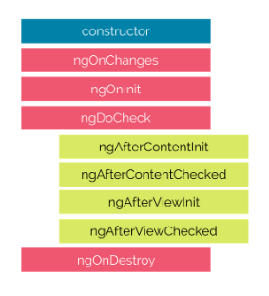
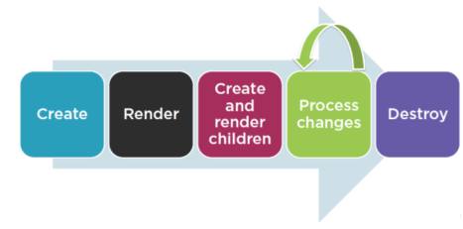
Life Cycle Hooks

Slide 3
Life Cycle Hooks
constructor | Invoked when Angular creates a component or directive by calling new on the class.
ngOnChanges | Invoked every time there is a change in one of the input properties of the component.
ngOnInit | Invoked when given component has been initialized, only called once after the first ngOnChanges
ngDoCheck | Invoked when the change detector of the given component is invoked. It allows us to implement our own change detection algorithm for the given component
ngAfterContentInit | Invoked after component content is initialized. Angular performs any content projection into the component’s view
ngAfterContentChecked | After every check of component content, Invoked each time the content of the given component has been checked by the change detection mechanism of Angular.
ngAfterViewInit | Invoked when the component’s view has been fully initialized.
ngAfterViewChecked | Invoked after every check of a component's views
ngOnDestroy | Just before the directive is destroyed. Invoked before Angular destroys the component/directive. Use this hook to unsubscribe observables and detach event handlers to avoid memory leaks.

Slide 4
Reactive Programming
Reactive programming - Creating the stream, emitting value, error or complete signals, manipulate, transfer or Transform the stream.
Streams (Sequence of values over period of time)
Observable (Observable converts the ordinary stream of data into an observable stream of data)
Observers / Subscribers (Observer must subscribe with the observable to receive the value.)

Slide 5
RxJs
RxJs (stands for *R*eactive E*x*tensions for *J*ava*S*cript, and it’s a library that provides an implementation of Observables for JavaScript.)
Category | Operators
Combination | combineLatest, concat, merge, startWith , withLatestFrom, zip
Filtering | debounceTime, distinctUntilChanged, filter, take, takeUntil
Transformation | bufferTime, concatMap, map, mergeMap, scan, switchMap
Utility | tap
Multicasting | share

Slide 6
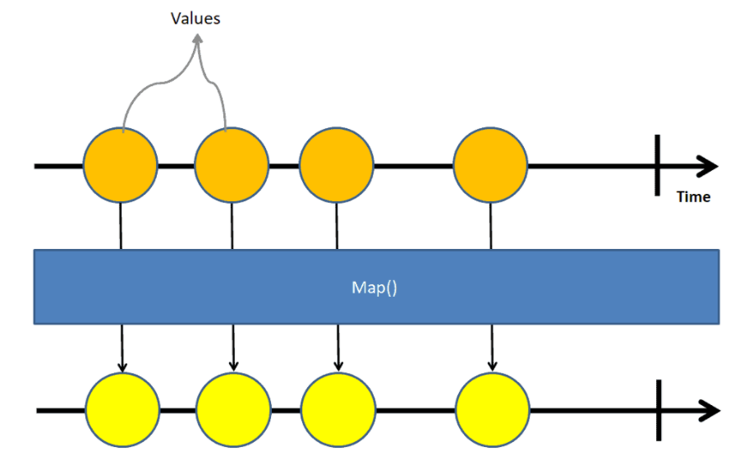
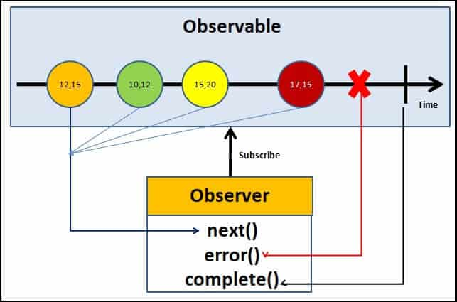
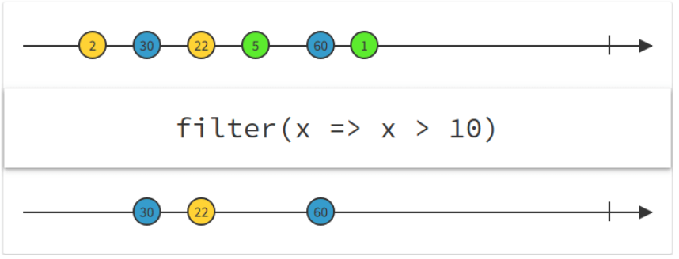
Understanding RxJs Operators

Slide 7
Angular uses RxJS library
EventEmitter - Under the hood this works via Observables.
Http
Reacting to an HTTP request
The HTTP module uses observables to handle AJAX requests and responses
Forms
Value changes / Status Changes in Angular Forms
The Router and Forms modules use observables to listen for and respond to user-input events.
Define custom events that send observable output data from a child to a parent component.

Slide 8
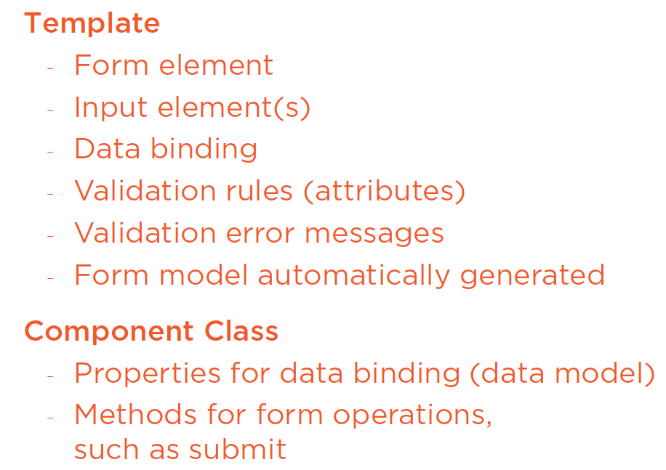
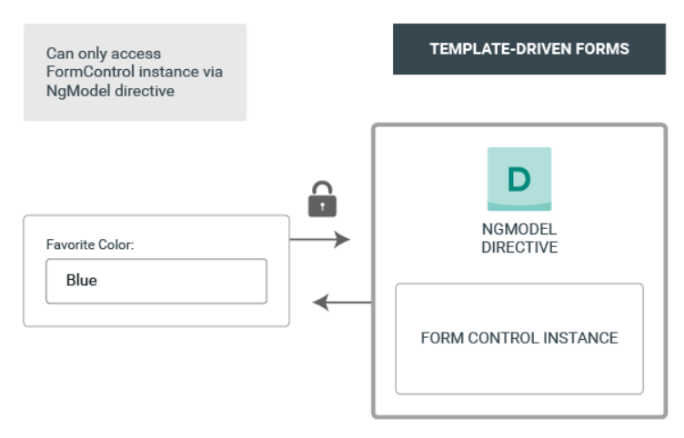
Template-Driven Forms

Slide 9
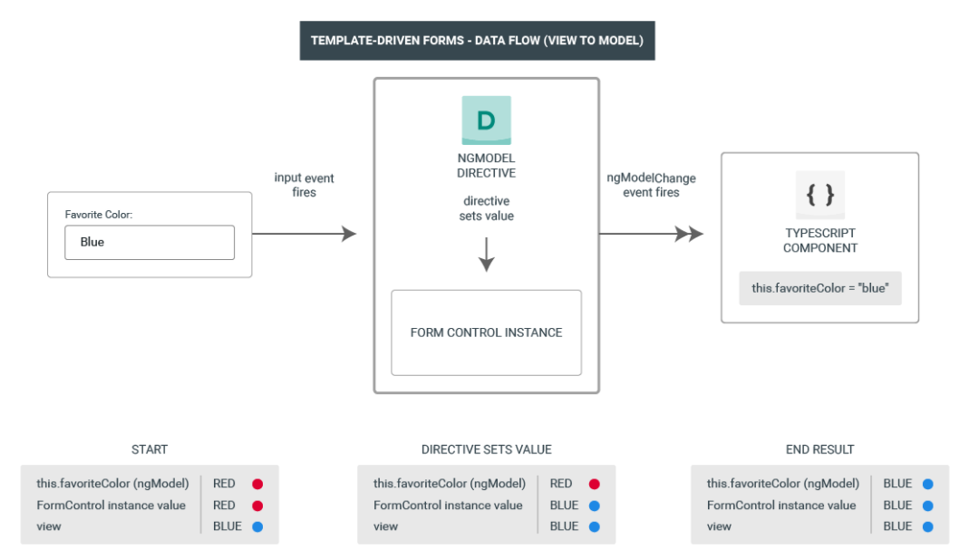
Template-Driven Forms : Data Flow

Slide 10
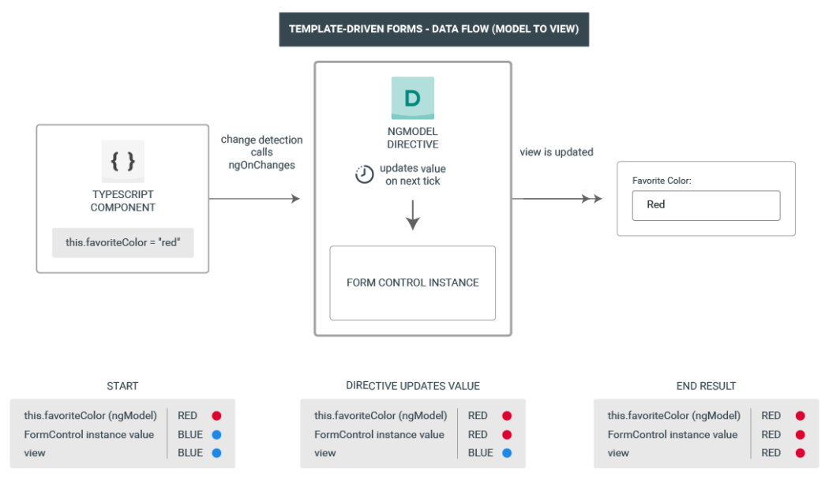
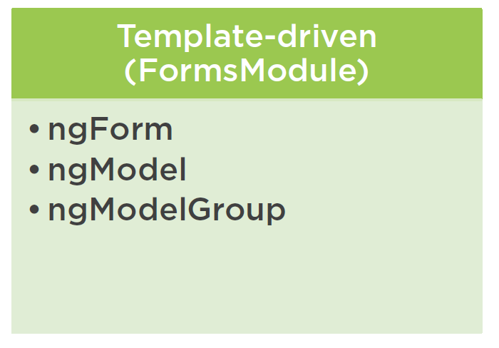
Template-Driven Forms : Data Flow

Slide 11
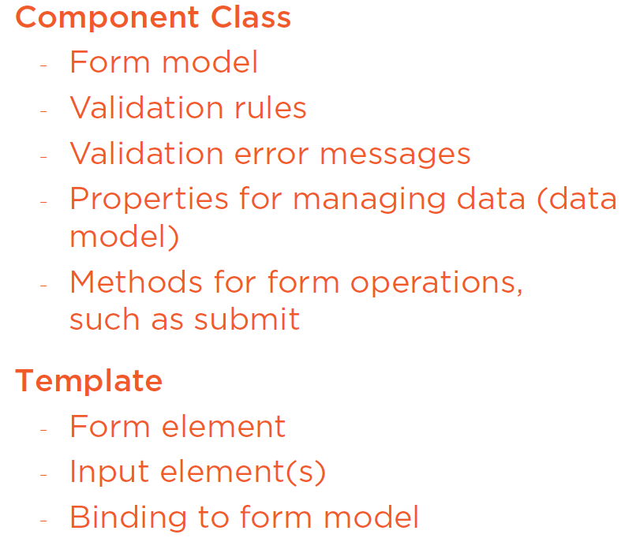
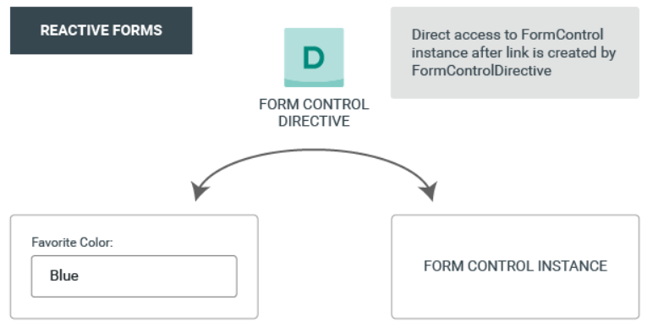
Reactive Forms

Slide 12
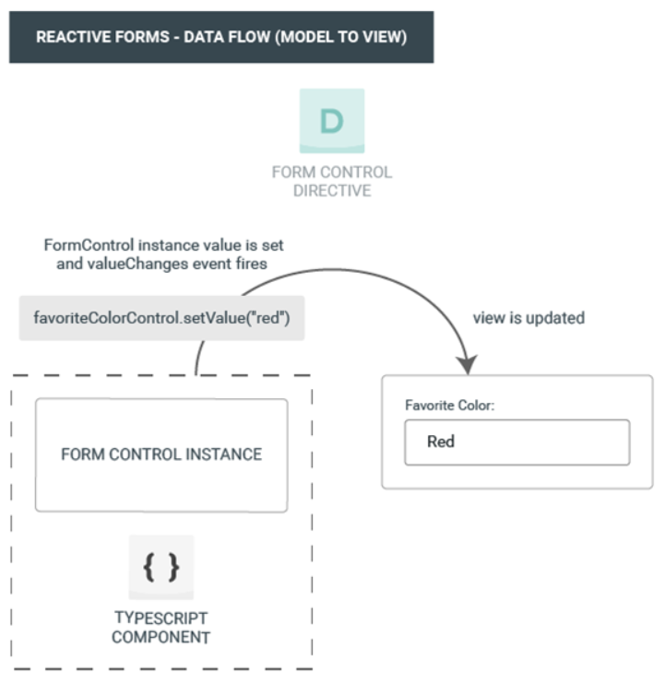
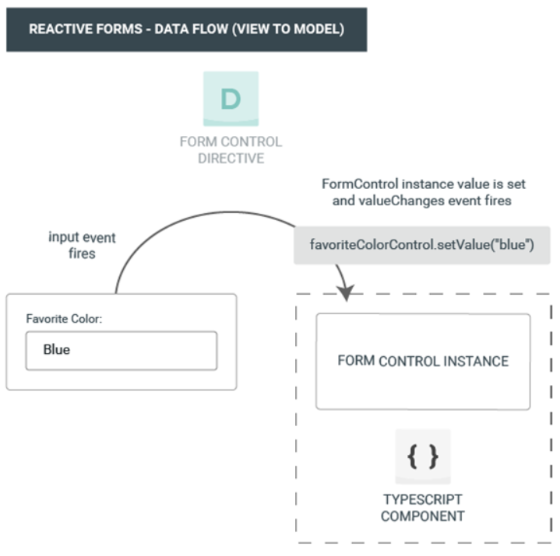
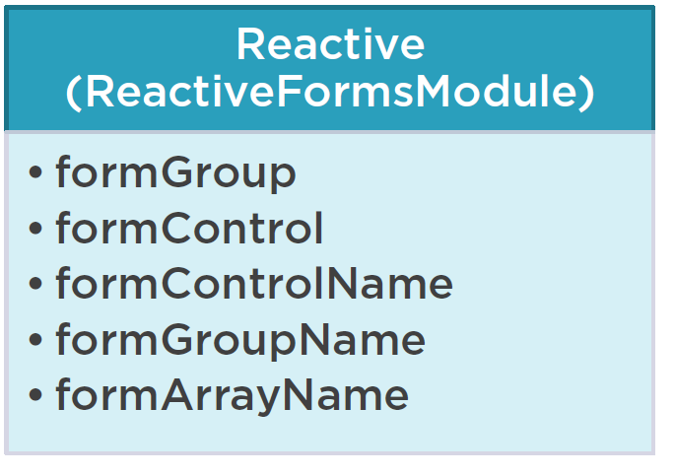
Reactive Forms – Data Flow

Slide 13
Template Driven Forms Vs Reactive Forms
 | Reactive | Template-Driven
Setup a form model | Explicit, created in component class | Implicit, created by directives
Data Model | Structured and immutable | Unstructured and mutable
Predictability | Synchronous | Asynchronous
Form Validation | Functions | Directives

Slide 14
Template Driven Forms Vs Reactive Forms
Template-Driven Forms
Use a component's template
Unit Test Against DOM
Easy to Use
Two-way data binding (Minimal Component code)
Automatically tracks form and input element state
Generated form model
HTML Validation

Slide 15
Template Driven Vs Reactive
Reactive Forms
Manually created from model
Use a component's Template
Create a Form Model in TS (in sync with the template)
Unit Test against Form Model
Validation in Form Model, class
More Flexible (more complex scenarios)
Immutable data model
Easier to perform an action on a value change
Reactive Transformation (Eg: DebounceTime or DistinctUntilChanged)
Easily add input elements dynamically
Easier Unit Testing
No Two-way data binding

Slide 16
DI & Providers
The DI framework in Angular consists of 4 concepts working together:
Token
This uniquely identifies something that we want injected. A dependency of our code.
Dependency
The actual code we want injected.
Provider
This is a map between a token and a list of dependencies.
Injector
This is a function which when passed a token returns a dependency (or list of dependencies).

Slide 17
DI & Providers
The DI framework in Angular consists of 4 concepts working together:
Token
This uniquely identifies something that we want injected. A dependency of our code.
Dependency
The actual code we want injected.
Provider
This is a map between a token and a list of dependencies.
Injector
This is a function which when passed a token returns a dependency (or list of dependencies).

